Slide 1
Keyboard Controls

Slide 2
Keyboard Events
Pygame is not designed to accept text-based input that we used in units 2 & 3
Pygame, however, is designed to have keyboard input as a basis for graphical controls & game mechanics
Pygame uses the keyboard to register two events:
  If a key is pressed a KEYDOWN event is generated
  If a key is released, a KEYUP event is generated
Pygame has mechanisms that can determine if modifiers were pressed (such as a shift key)

Slide 3
Key Events
Each Key event has one main attribute: an identifier to indicate what key was pressed/released
The key pressed is an integer. Refer to the web page http://www.pygame.org/docs/ref/key.html for a list of all possible Pygame key codes

Slide 4
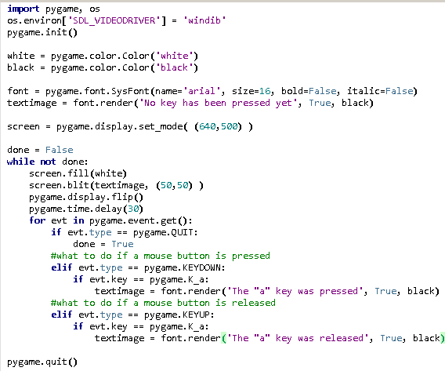
Example 1 – Registering Key Events

Slide 5
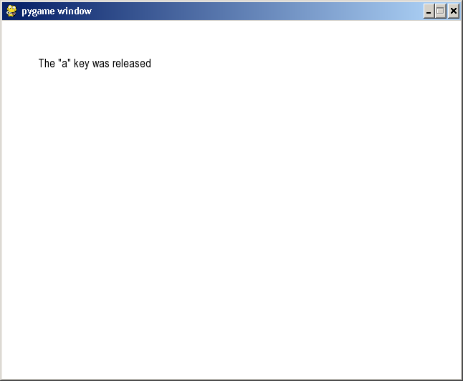

Slide 6
Example 2 – Using Keyboard Controls
Key events are very useful for introducing keyboard controls. Often it can be very easy to map certain keys to certain changes in graphical displays.
The following program allows a red box to be manipulated using the keyboard arrow keys

Slide 7
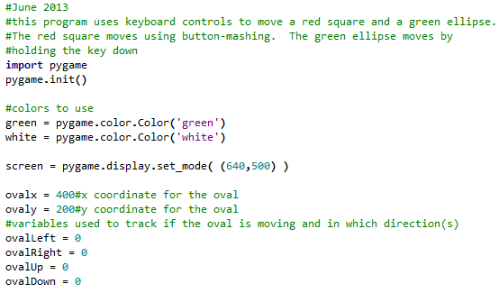
Example 2 – Moving an Oval

Slide 8
